Slide 1
FTICR-MS Data Analysis Tutorial
Bob Danczak
Pacific Northwest National Laboratory

Slide 2
Before we begin!
Before we begin, you’ll need to download some files. They are outlined on the tutorial GitHub page which can be found here: https://github.com/danczakre/ICRTutorial
You’ll need to navigate to the “Code” dropdown menu, and select “Download ZIP”
Once downloaded, you can double-click to unzip it (on both Windows and MacOS)
You will find most of the files that we will need for the tutorial today within the “EMSL Summer School 2020” folder
You also need to have R and RStudio to follow along completely with the tutorial
In addition to these files, there are some files stored as part of PNNL that you will need
Formularity: https://omics.pnl.gov/software/formularity
WHOI Molecular Formula Database: https://omics.pnl.gov/software/formularity
This step only works on Windows, unfortunately

Slide 3
Organization of this tutorial
Overview of FTICR-MS as a technique, WHONDRS, and how to access WHONDRS data
What is an FTICR-MS and what does the data look like?
How is the data handled before it is uploaded?
Where can you find FTICR-MS data?
Walkthrough of common data analysis pipelines
Pre-processing data using the ftmsRanalysis R package
Generating Van Krevelen plots to compare molecular composition
Comparing molecular properties across samples
Examining other analytical techniques
Multivariate analyses (i.e., PCA, NMDS)
The transformation analysis

Slide 4
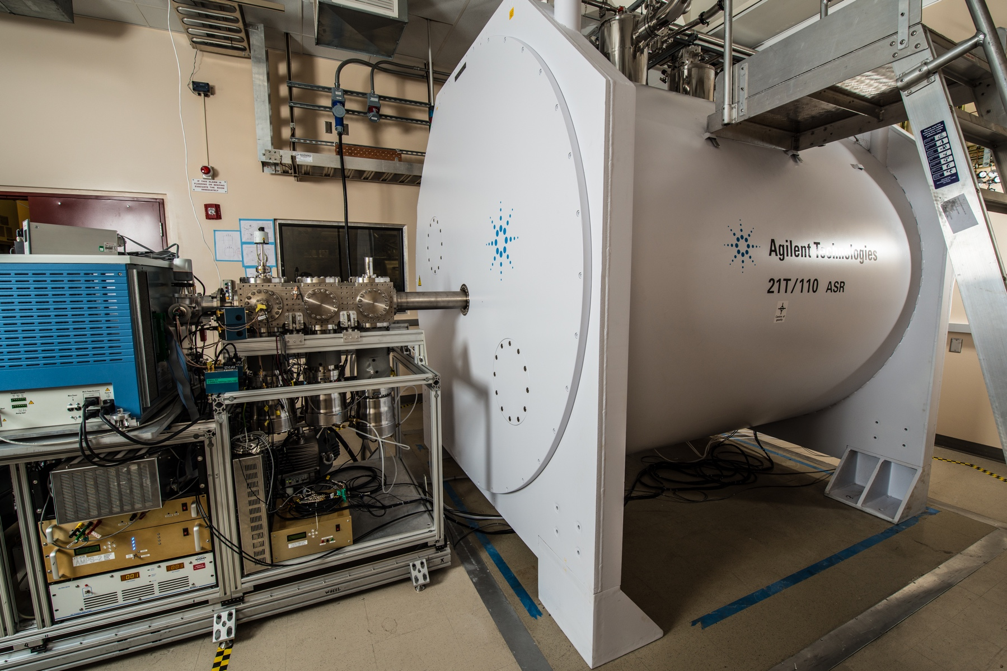
Fourier Transform Ion Cyclotron Resonance Mass Spectrometry can detect carbon compounds
Fourier Transform Ion Cyclotron Resonance Mass Spectrometry (FTICR-MS) can detect many carbon compounds due to ultra-high mass resolution and accuracy
The MagLab has a great overview of the FTICR-MS
Using these specific masses, we can assign molecular formulas based upon previously compiled databases
Today we will be focusing on downloading data from existing sources, processing it, and generating figures for interpretation
Pre-processing FTICR-MS has many considerations that we will not be discussing
21T FTICR-MS at EMSL

Slide 5
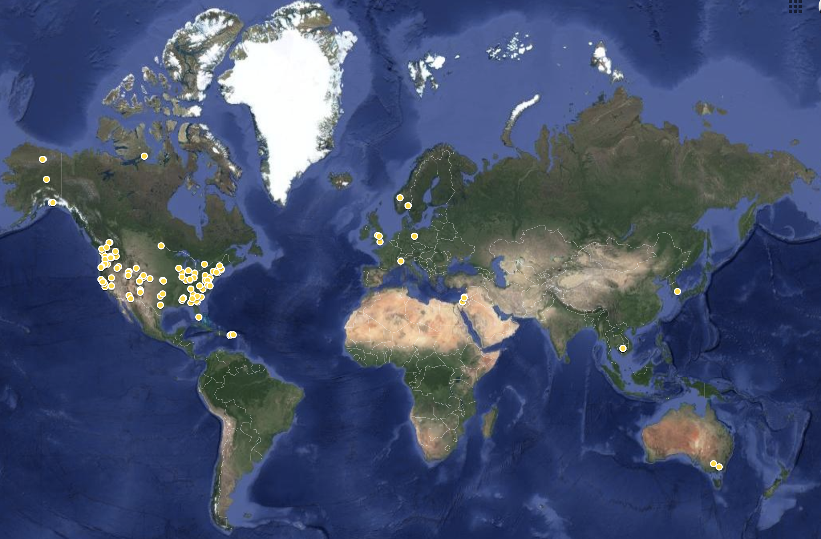

FTICR-MS Data and WHONDRS
WHONDRS (Worldwide Hydrobiogeochemistry Observation Network for Dynamic River Systems) collects samples from hydrologically dynamic rivers throughout the world via distributed sampling
Many data types, including FTICR-MS, are collected from each sample
Data is uploaded to ESS-DIVE for public use
As part of WHONDRS, we pre-process the data so researchers can take the data and answer the questions that interest them
whondrs.pnnl.gov

Slide 6
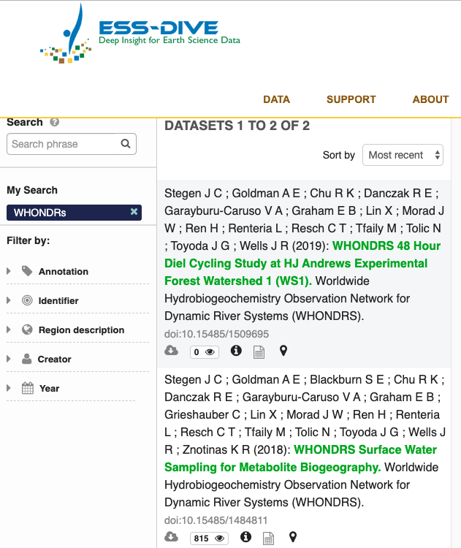
Downloading WHONDRS data from ESS-DIVE
All WHONDRS FTICR-MS data will be available DOE’s ESS-Dive data archive (data.ess-dive.lbl.gov/data)

Slide 7
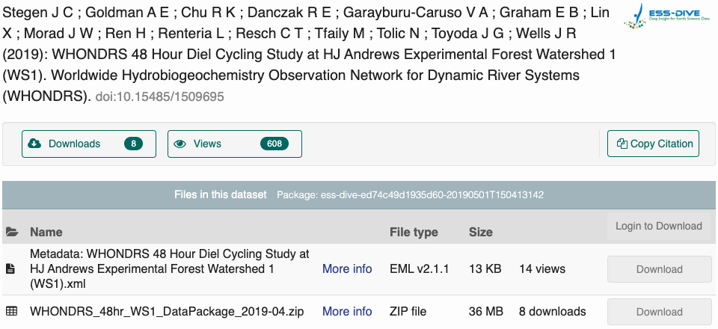
Downloading WHONDRS data from ESS-DIVE
All WHONDRS FTICR-MS data will be available DOE’s ESS-Dive data archive (data.ess-dive.lbl.gov/data)

Slide 8
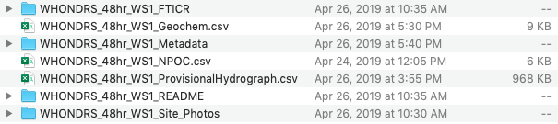
Downloading WHONDRS data from ESS-DIVE
All WHONDRS FTICR-MS data will be available DOE’s ESS-Dive data archive (data.ess-dive.lbl.gov/data)

Slide 9
Downloading WHONDRS data from ESS-DIVE
All WHONDRS FTICR-MS data will be available DOE’s ESS-Dive data archive (data.ess-dive.lbl.gov/data)
All the FTICR-MS data will be contained within this folder

Slide 10
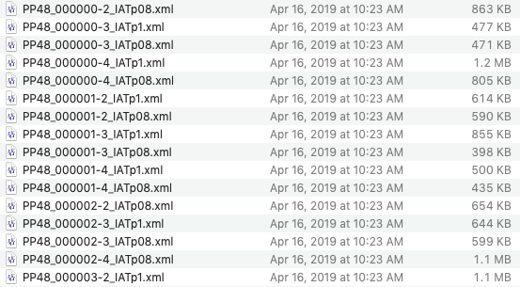
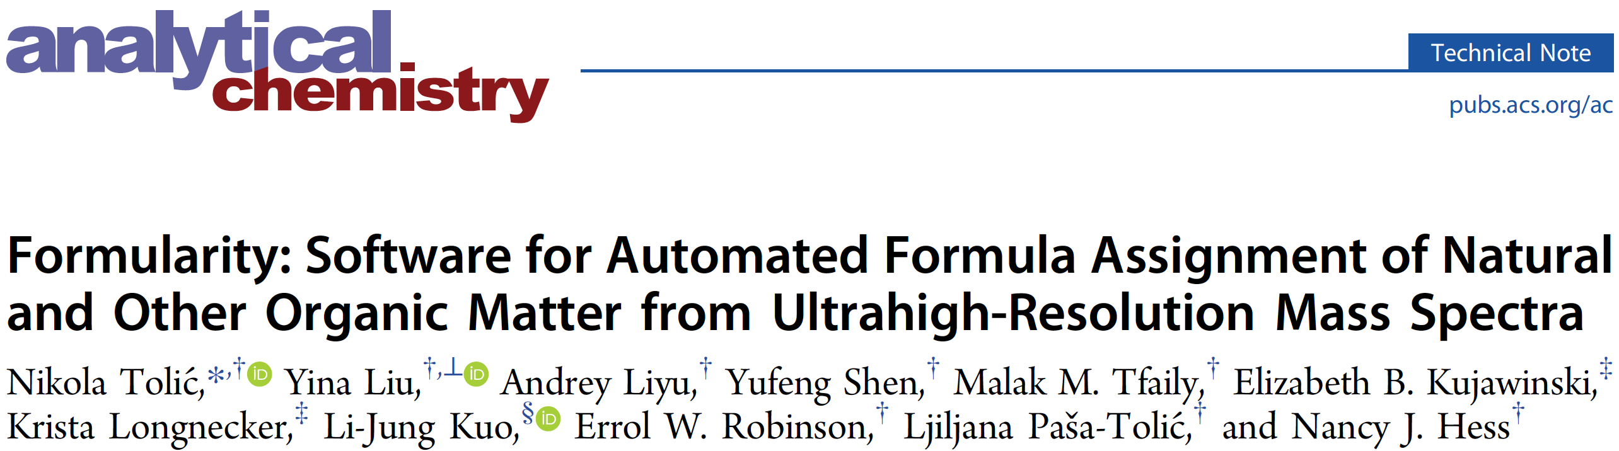
How do we process the data obtained from ESS-DIVE
The data contained within WHONDRS data packages undergone some processing but needs additional adjustments to be useful
For this we use a program called Formularity (Tolic et al., 2017 – Anal. Chem.)
This program will calibrate peaks, assign molecular formulas, and allow data to be analyzed together
Important FTICR-MS caveat: this data provides molecular formula, not compounds as no structural information is provided
Formularity will create a ‘report’ which is used for all downstream analyses
This report includes molecular formulas, samples, etc. and is used in downstream analyses

Slide 11
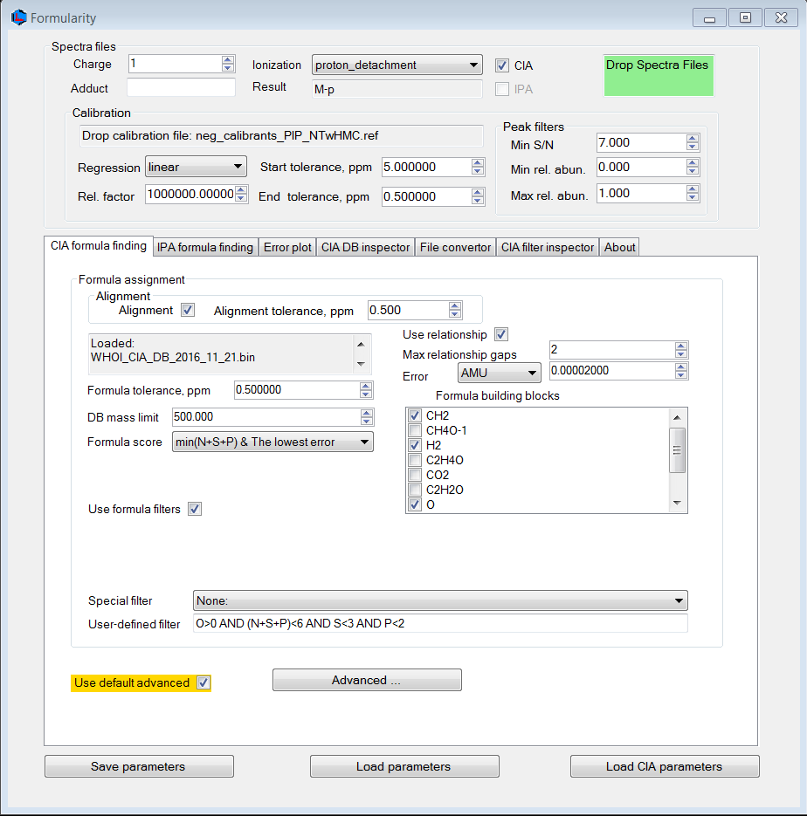
Let’s Generate a Formularity Report
Formularity requires Windows, so those running MacOS or Linux can’t participate unfortunately
Drag and Drop
Calibration_List.ref
Drag and Drop
WHOI Molecular Formula Database
Formularity supports dragging and dropping of necessary files
First, we need to load up the calibration list and molecular formula database

Slide 12
Let’s Generate a Formularity Report
Formularity requires Windows, so those running MacOS or Linux can’t participate unfortunately
Ensure CIA is checked
Under Calibration
Start tolerance, ppm: 5
Regression: linear
Under Formula Assignment
Alignment: Checked
Alignment tolerance, ppm: 0.5
Max relationship gaps: 2
Set the User-defined filter:
O>0 AND (N+S+P)<6 AND S<3 AND P<2

Slide 13
Let’s Generate a Formularity Report
Formularity requires Windows, so those running MacOS or Linux can’t participate unfortunately
Drag and Drop
Once you drop the .xml files onto the now green “Drop Spectra Files” box, Formularity will begin to get to work
It may seem like nothing is happening, but in a few minutes, you should have two files in the directory containing the .xml files
Report.csv and a .log file

Slide 14
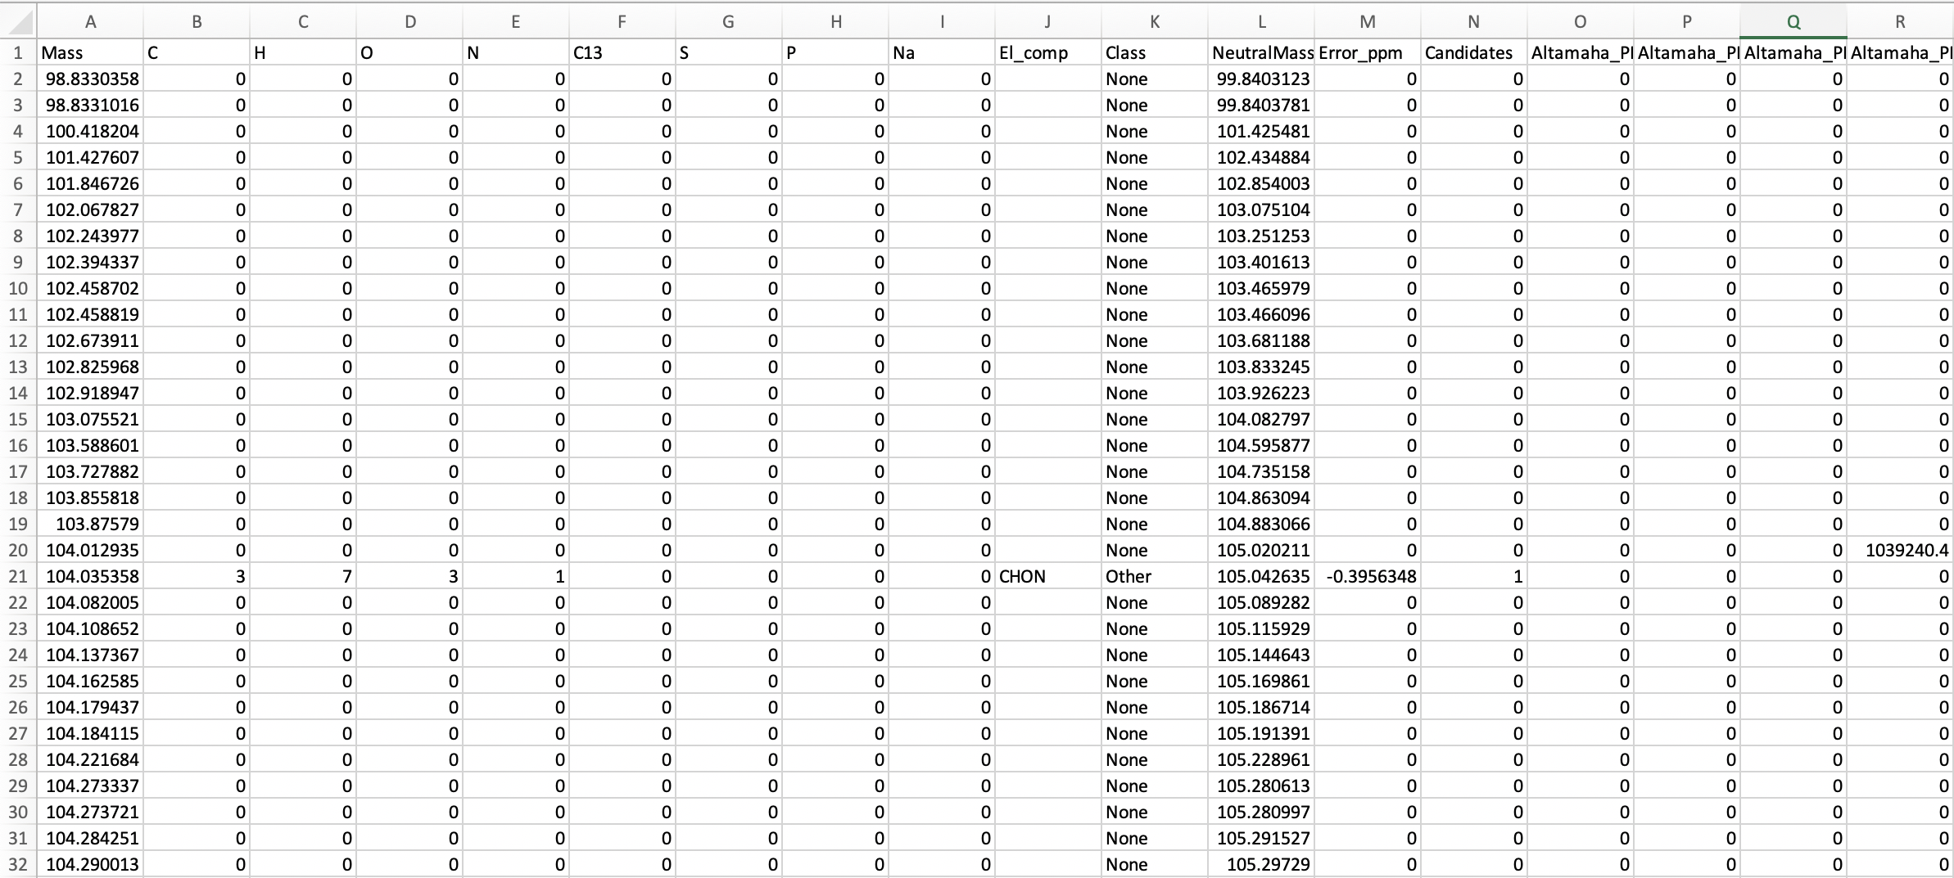
The Formularity report contains a lot of information
Class
Error
Mass
Stoichiometry
Composition
Neutral
Mass
Formula
Candidates
Samples

Slide 15
Organization of this tutorial
Overview of FTICR-MS as a technique, WHONDRS, and how to access WHONDRS data
How is the data handled before it is uploaded?
Where can you find FTICR-MS data?
What does the data look like?
Walkthrough of common data analysis pipelines
Pre-processing data using the ftmsRanalysis R package
Generating Van Krevelen plots to compare molecular composition
Comparing molecular properties across samples
Examining other analytical techniques
Multivariate analyses (i.e., PCA, NMDS)
The transformation analysis

Slide 16
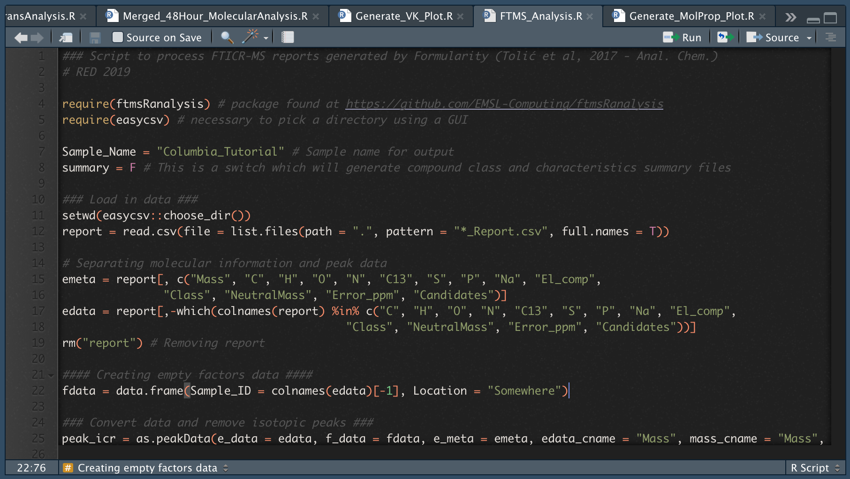
Data Pre-processing
This is a quick view of the FTMS_Analysis.R which utilizes the ftmsRanalysis package
Pressing the “Source” button will run the entire script
You should see a pop-up asking you to select the directory containing the Report
This script will generate two files, a Data and Mol file.
Removes peaks with an isotopic signature, and filters based upon a mass range of 200-900 m/z

Slide 17

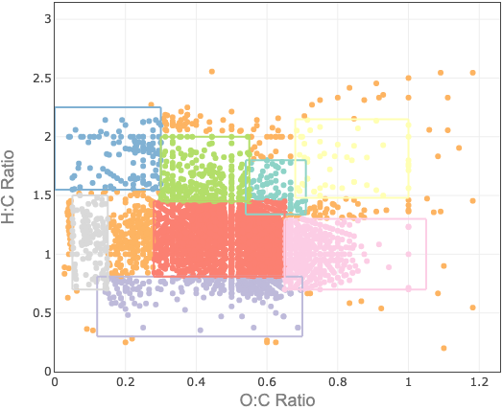
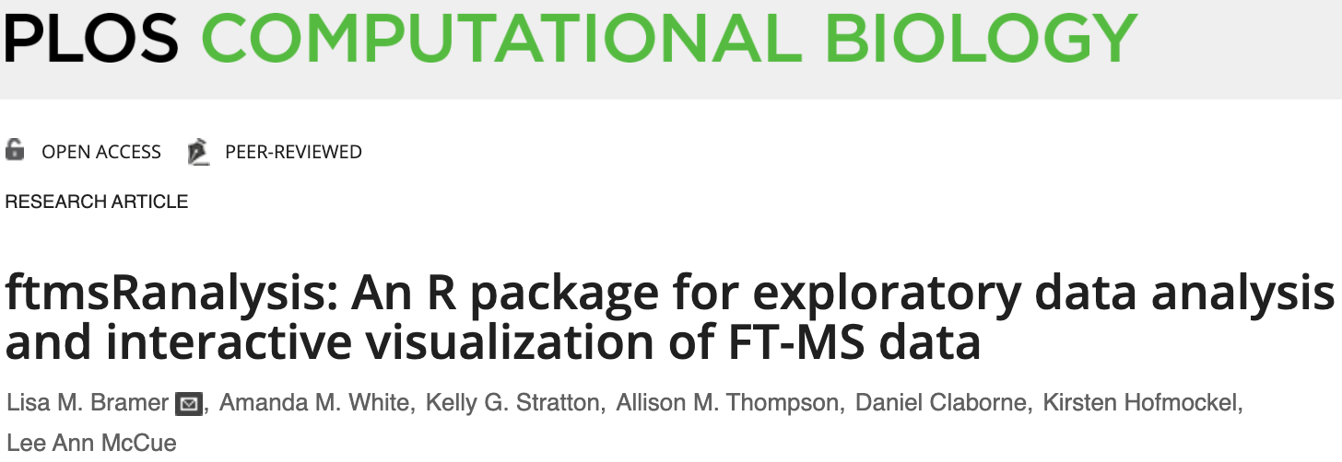
The ftmsRanalysis package helps generate files which will be used in all downstream analyses
Two new files should have been generated – take some time to explore them
The Data file contains the mass-by-site information
The Mol file contains molecular information for each formula (i.e., stoichiometry, NOSC)
These two files are useful in downstream analsyes
What types of carbon are present, and do they change through space/time?
Are the profiles similar or distinct to each other?
We will walk through two specific analyses: generating a Van Krevelen plot and comparing molecular properties
Data
Mol
Van Krevelen Plots
Molecular Properties

Slide 18
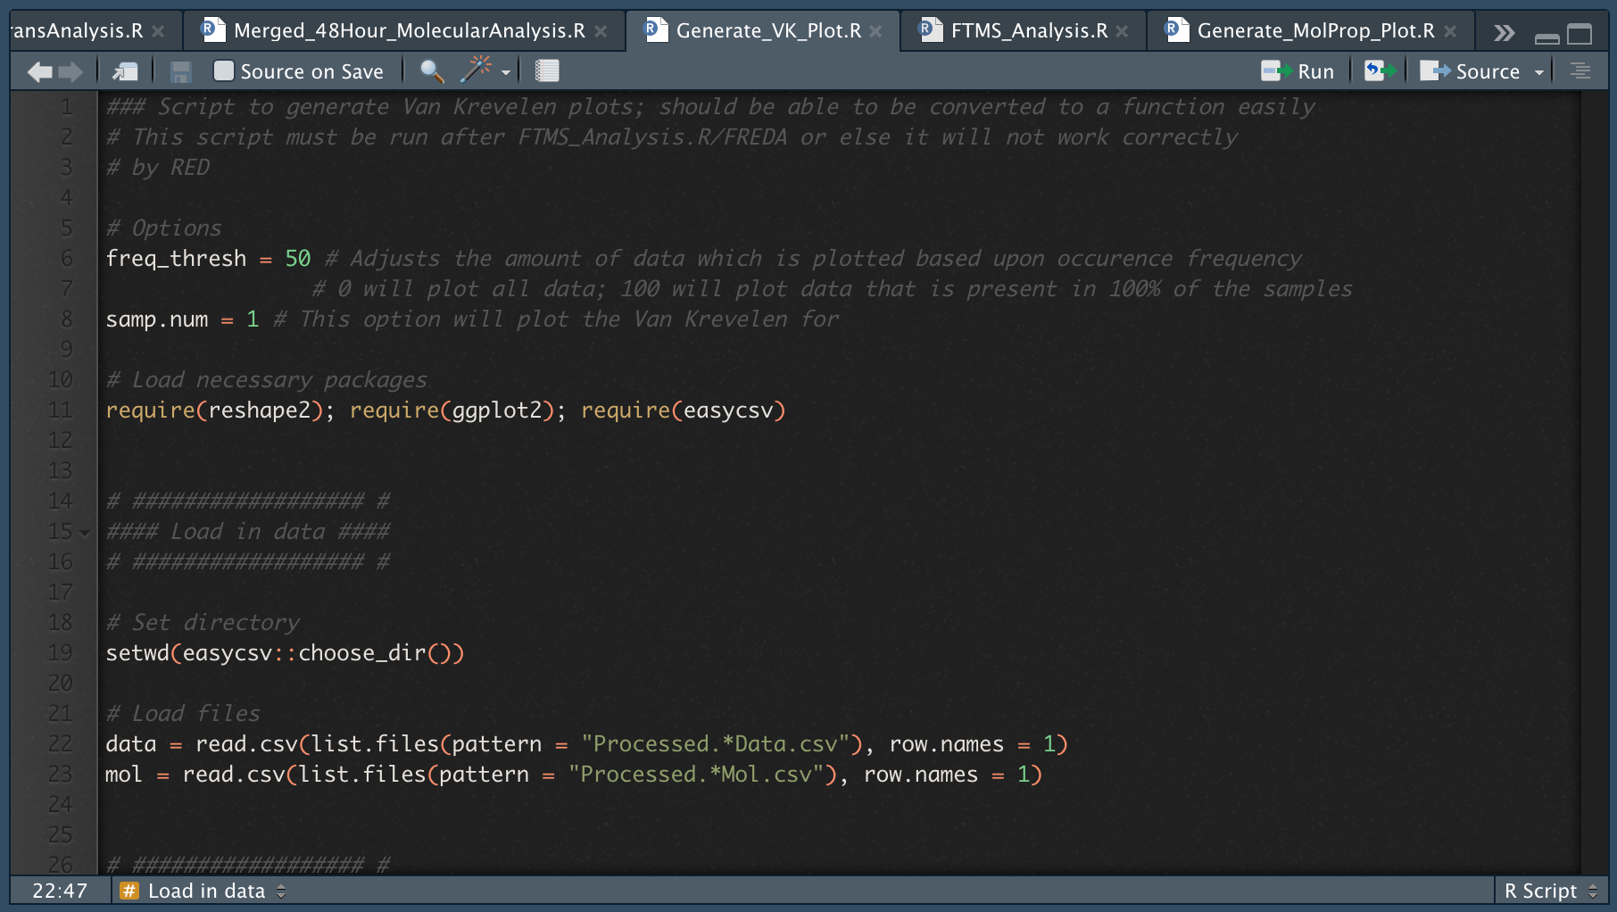
Generating van Krevelen plots
This is a quick view of the Generate_VK_Plot.R script
Pressing the “Source” button will run the entire script
You should see a pop-up asking you to select the directory containing the Data and Mol files
This script will generate 2 VK plots: one featuring all data and another for the specified sample

Slide 19
Van Krevelen plots can reveal broad molecular patterns
Van Krevelen plots are useful in evaluating the overall ‘molecular landscape’ of your samples
Plots the hydrogen:carbon (H:C) atomic ratio of each compound against the corresponding oxygen:carbon (O:C) atomic ratio
Different boundary sets can reveal molecular formula dynamics
Combinations of different H:C and O:C values correspond to compound classes
For example, lignin-like molecular formula seem to constitute a high proportion of the Columbia River
Other boundary sets and coloring schemes can help reveal important patterns in your dataset
All Data

Slide 20
Generating van Krevelen plots again!
This is a quick view of the Generate_VK_Plot.R script
Pressing the “Source” button will run the entire script
These options will change the output figures – freq_thresh will adjust the minimum frequency for a compound while samp.num will select a specific sample
You should see a pop-up asking you to select the directory containing the Data and Mol files

Slide 21
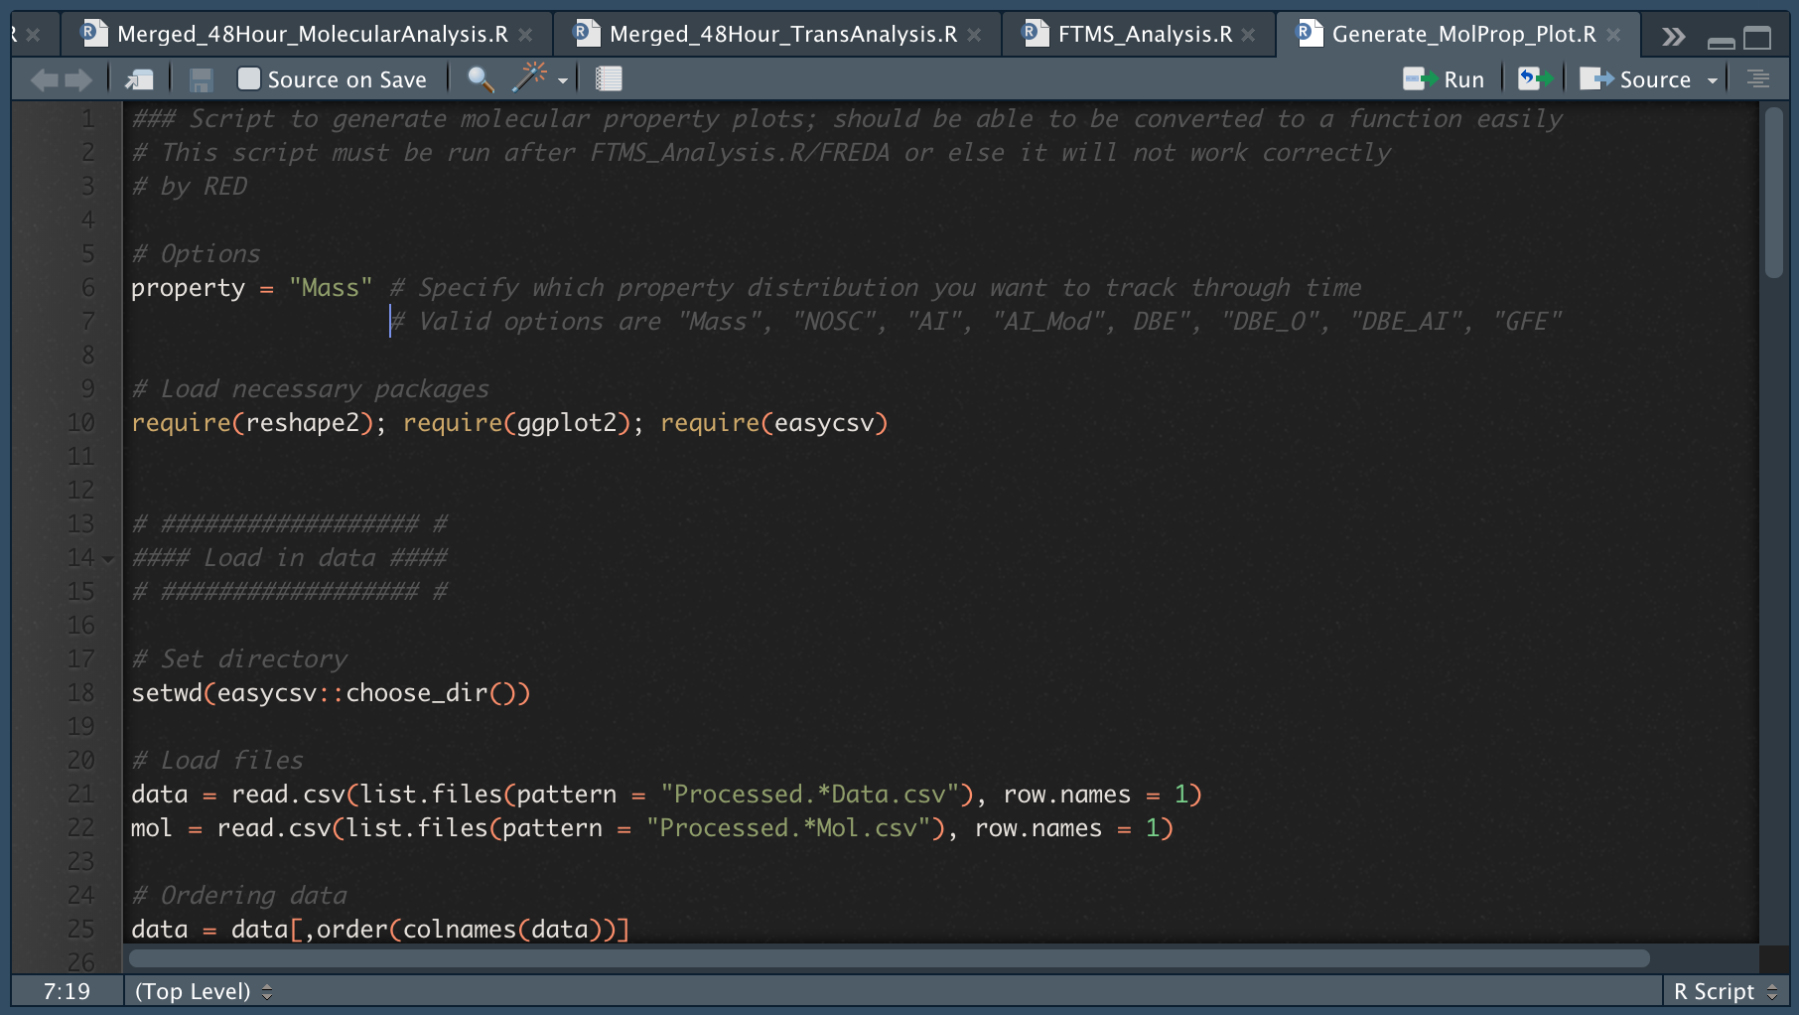
Analyzing molecular properties
This is a quick view of the Generate_MolProp_Plot.R script
Pressing the “Source” button will run the entire script
You should see a pop-up asking you to select the directory containing the Data and Mol files
This script will generate 2 plots which track molecular properties through time

Slide 22
Patterns in molecular properties can reveal ecosystem dynamics
The script will generate two plots:
One plot tracks the distributions of a given property by sample (here, the Mass of detected compounds)
The other is a bar chart for the average value of multiple derived properties of each sample
While the distribution of masses is plotted in this boxplot plot, we can look at other variables:
NOSC (Nominal Oxidation State of Carbon) can give insight into potential thermodynamics
AI (Aromaticity Index) and DBE (Double-Bond Equivalents) can reveal patterns in compound properties
Elemental ratios (i.e., H:C, O:C, N:C, P:C) can reveal patterns in molecular formula
All these metrics are derived from the stoichiometry and are dependent upon formula assignment

Slide 23
Analyzing molecular properties
This is a quick view of the Generate_MolProp_Plot.R script
Pressing the “Source” button will run the entire script
This option will change the individually plotted parameter
You should see a pop-up asking you to select the directory containing the Data and Mol files
This script will generate 2 plots which track molecular properties through time

Slide 24
Organization of this tutorial
Overview of FTICR-MS as a technique, WHONDRS, and how to access WHONDRS data
How is the data handled before it is uploaded?
Where can you find FTICR-MS data?
What does the data look like?
Walkthrough of common data analysis pipelines
Pre-processing data using the ftmsRanalysis R package
Generating Van Krevelen plots to compare molecular composition
Comparing molecular properties across samples
Examining other analytical techniques
Multivariate analyses (i.e., PCA, NMDS)
The transformation analysis
Lambda Theory

Slide 25
Multivariate analyses can reveal broad spatiotemporal trends
Multivariate analyses can reveal important patterns across your datasets
Principal component analyses (PCA), principal coordinate analysis (PCoA), and non-metric multidimensional scaling (NMDS) analyses are all valid approaches
Here we have a Jaccard-based NMDS of the 7 rivers you’ll be working with this afternoon fitted with derived metrics
Erpe River appears to be related to peak counts while the Columbia River is related by high NOSC
Note: When comparing many different samples, data must be converted to presence/absence

Slide 26
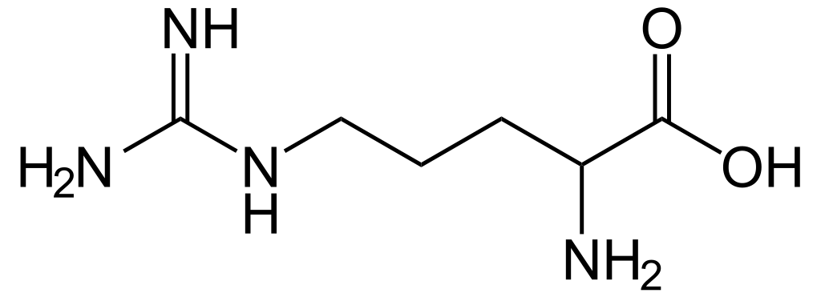
The Transformation Analysis
Example of a transformation
The ultra-high mass resolution and accuracy of FTICR data enables us to perform a transformation analysis
By calculating the mass difference between peaks, we use a database to identify putative biochemical transformations
These transformations can be used to construct a transformation network
We will not be covering this in detail, but differences in networks might be indicate differing biochemical capabilities
Difference of ~156.1011167 m/z
Compound 1
(541.1563282 m/z)
Compound 2
(385.0552115 m/z)
~156.1011167 m/z
=
Arginine
Transformation Network

Slide 27
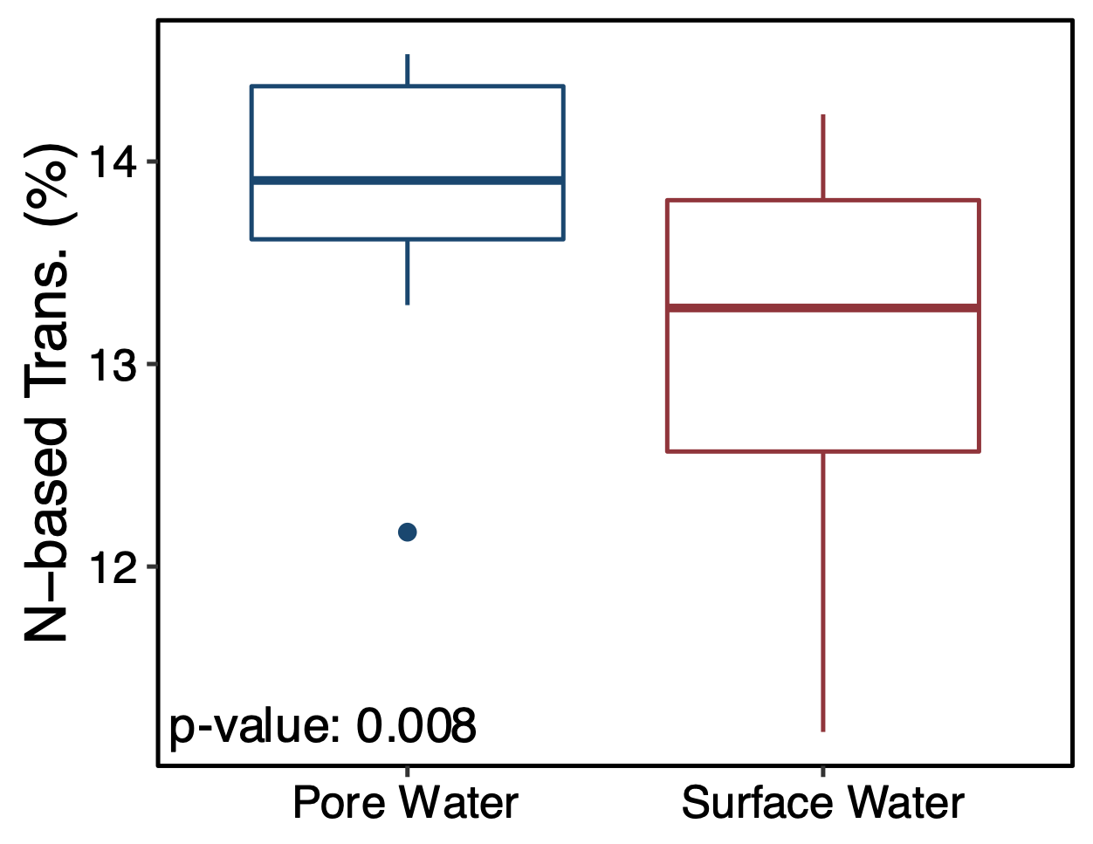
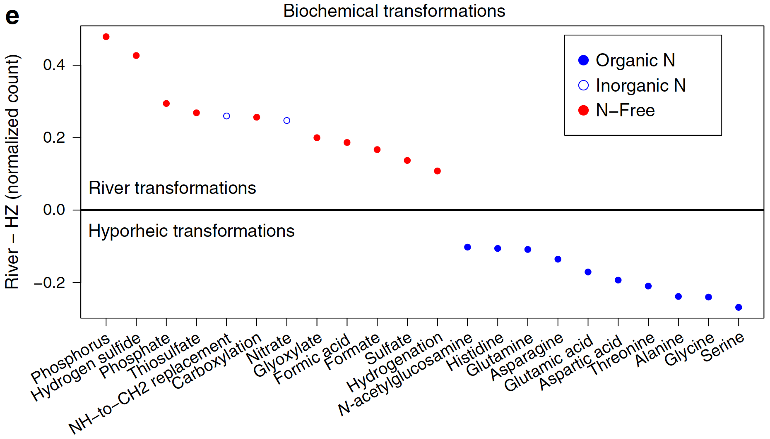
Differences in biochemical transformations can reveal biogeochemical patterns
By comparing the proportion of different transformation types across groups, biogeochemically relevant patterns can be uncovered
Past and ongoing research has demonstrated that nitrogen-based transformations might be more important in pore water/hyporheic zones than surface water
This indicates a potential link between nitrogen requirements and biogeochemistry
Extending these analyses to other ecosystems will help reveal generalizable biochemical patterns
HJ Andrews Exp. Forest, Oregon
Danczak et al., in prep
Columbia River, Washington
Stegen et al., 2018 – Nat. Comm.

Slide 28
Applying FTICR-MS data to biogeochemical modeling
Thermodynamic representation of energy coupling
Using calculations from Hyun Seob Sung, we can measure carbon use efficiency based upon molecular formula
Using λ, we can derive the “stoichiometric coefficient” or Y_{Cs,i} – the number of moles of carbon required to generate biomass
This afternoon you’ll be calculating these metrics using FTICR-MS data collected by WHONDRS
By tracking carbon use efficiency or the thermodynamic coefficient (λ) through space/time, we can begin predicting respiration rates and investigate biogeochemical cycles
S(E_{d}, E_{a})
P
Catabolism
ΔG_{Cat}
ΔG_{Dis}
Metabolic
reaction
ΔG_{An}
Dissipation
(constant fraction)
Anabolism
Cs, Ns
Biom
λ is the number of times the catabolic reaction runs to produce one C-mole of biomass
Song et al., in prep

Slide 29
Concluding Remarks
Analyzing FTICR-MS data presents some unique challenges, but WHONDRS hopes to break down barriers
We collect and analyze data according to standardized, consistent protocols for maximum comparability
Data will be uploaded to public databases as quickly as possible to allow others to answer potentially interesting questions
All the scripts used today will continue to be hosted on the provided GitHub page (https://github.com/danczakre/ICRTutorial)
Given the challenges of FTICR-MS data analysis, we are planning on expanding this page into a more general walkthrough to help explain other analysis pathways
There are currently some other analyses hosted from previous workshops
FTICR-MS data is rich and deep – we are only scratching the surface of its potential

Slide 30

Acknowledgements
The WHONDRS team
Amy Goldman
Vanessa Garayburu-Caruso
Lupita Renteria
Josh Torgeson
Jackie Wells (Ore. St.)
Joseph Morad
Sawi Kumar
Marcy Mccall
James Stegen
Emily Graham
Environmental Molecular Sciences Laboratory (EMSL)
Nikola Tolic
Rosey Chu
Jason Toyoda
Everyone who helped develop FREDA and ftmsRanalysis
Lisa Bramer
Allison Thompson
Everyone who sent in samples for WHONDRS

